Slide 1
Unit 4
Graph

Slide 2
A graph is a collection of data item called node where nodes are connected to each other by the help of edge.
A graph is an abstract data type (ADT) which consists of a set of objects that are connected to each other via links. The interconnected objects are represented by points termed as vertices, and the links that connect the vertices are called edges.

Slide 3
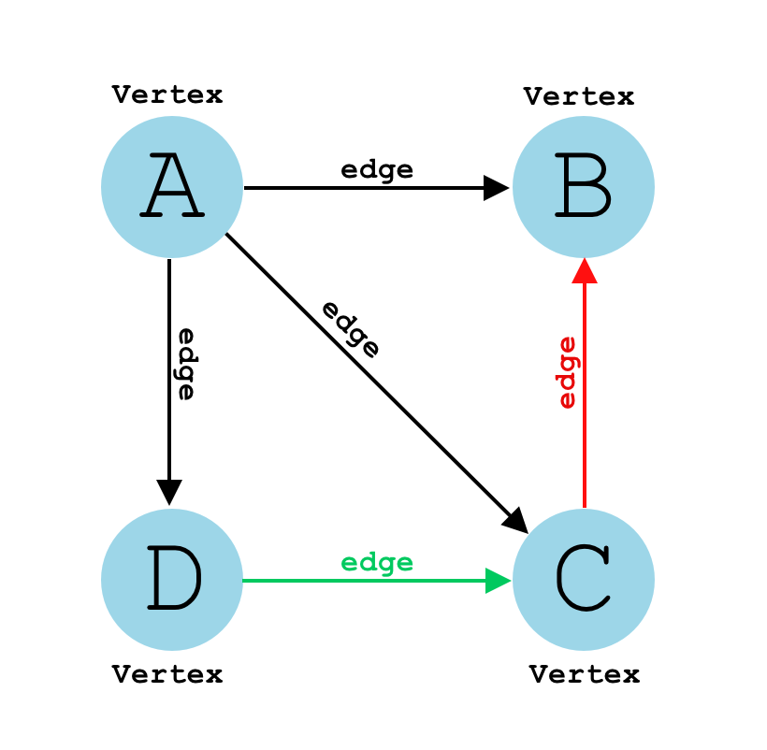
Note:-
A graph G can be represent[ed] an ordered pair i.e G = (V, E)
Where, 'V' indicates no. of vertices or nodes and 'E' indicates no. of edges.

Slide 4
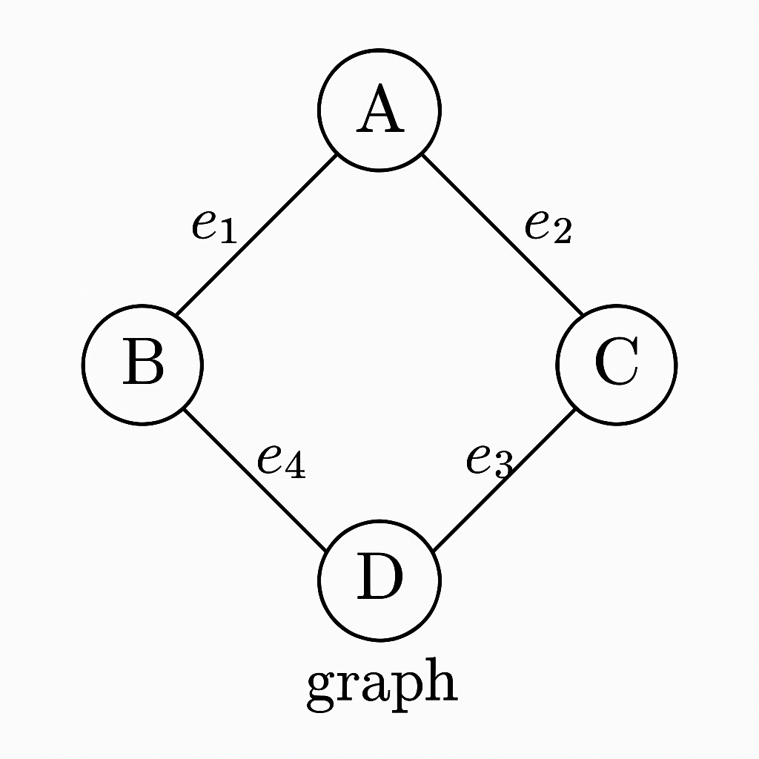
Vertex
Edges

Slide 5
Graphs are used to represent and solve problems where the data consists of objects and relationships between them, such as:
Social Networks: Each person is a vertex, and relationships (like friendships) are the edges. Algorithms can suggest potential friends.
Maps and Navigation: Locations, like a town or bus stops, are stored as vertices, and roads are stored as edges. Algorithms can find the shortest route between two locations when stored as a Graph.
Internet: Can be represented as a Graph, with web pages as vertices and hyperlinks as edges.
Biology: Graphs can model systems like neural networks or the spread of diseases.

Slide 6
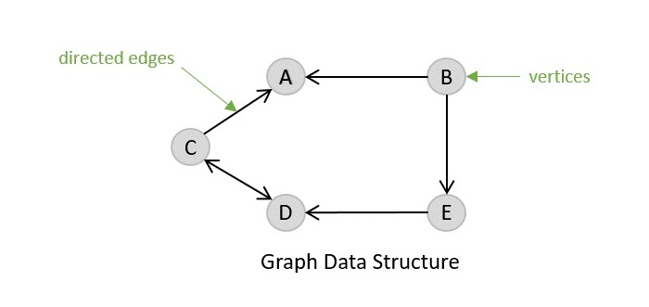
Types of graph
1. Directed Graph
2. Undirected Graph
1. Directed Graph
Directed graph, as the name suggests, consists of edges that possess a direction that goes either away from a vertex or towards the vertex.

Slide 7
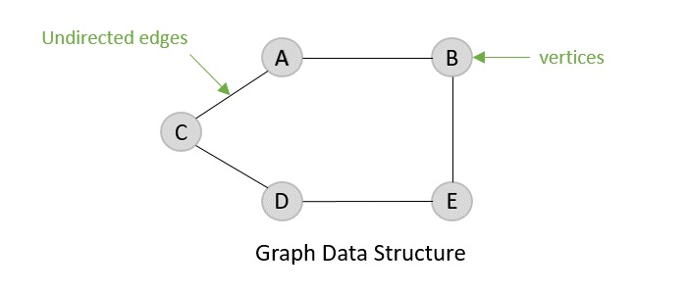
2. Undirected Graph
Undirected graphs have edges that are not directed at all.

Slide 8
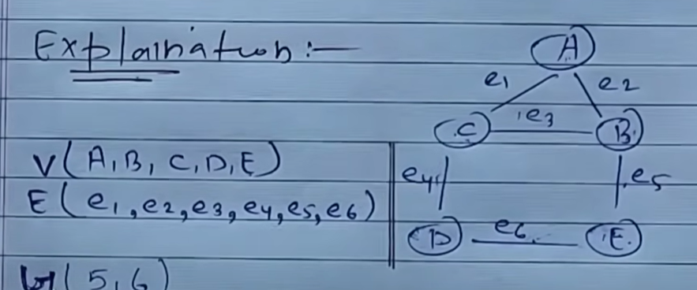

Slide 9
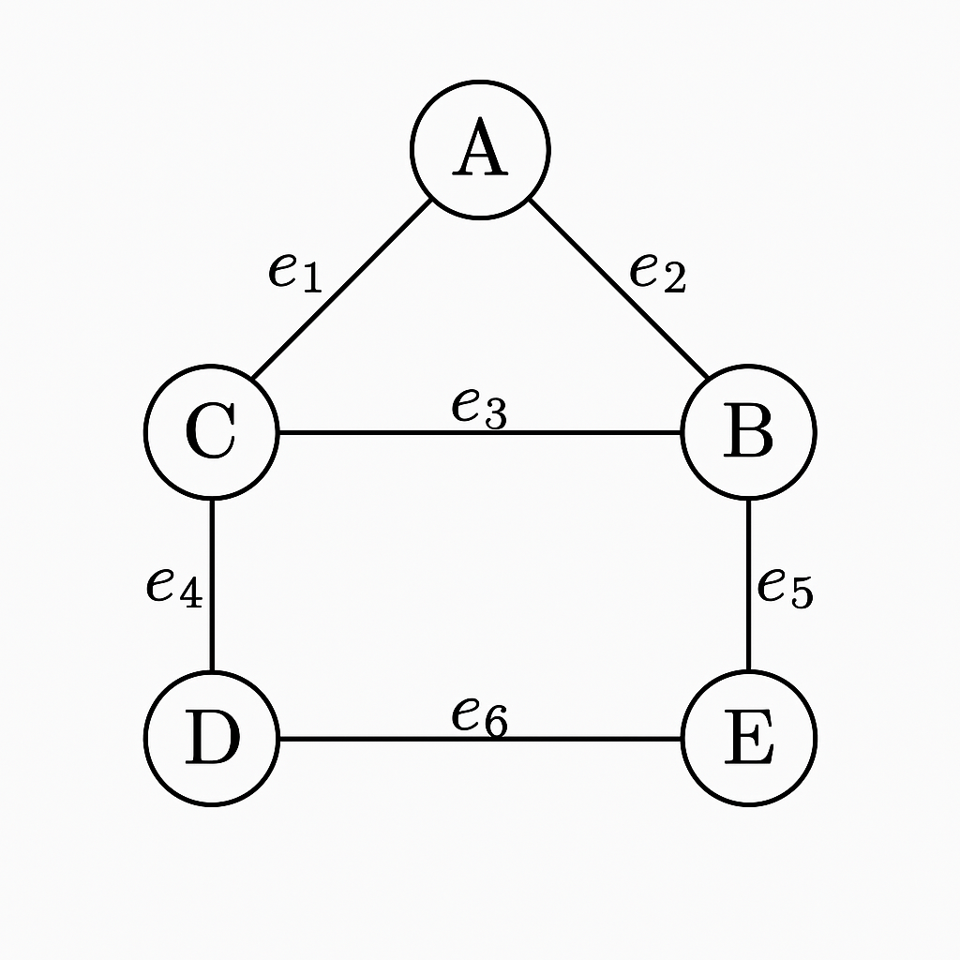
Vertices: A, B, C, D, E Edges:
e₁: A — C
e₂: A — B
e₃: C — B
e₄: C — D
e₅: B — E
e₆: D — E

Slide 10
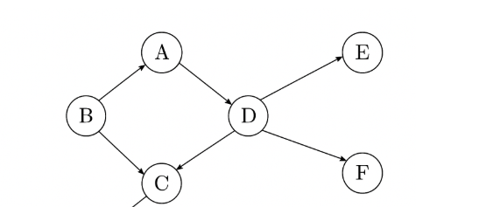
Terminology of Tree
Path:- A open walk in which no vertex appears more than once is called a path.
Paths Listed:
A → F
A → D → F
A → B → C → D → F

Slide 11
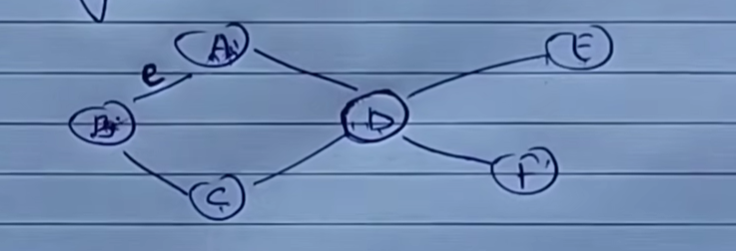
2. Adjacent nodes
When there is an edge from one node to another then these nodes are called adjacent nodes.
If two nodes A and B are connected via an edge (E), then the nodes A & B are called as neighbors.

Slide 12
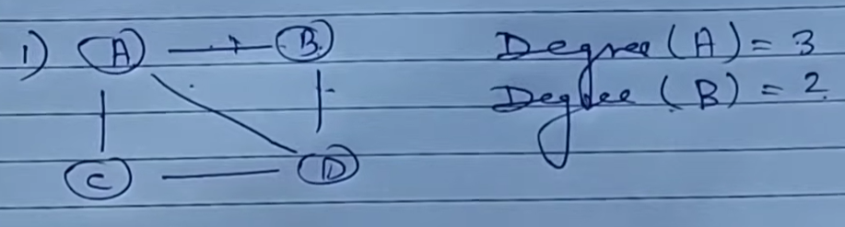
3.Degree
Total number of edges connected to a vertex is said to be degree of that vertex.

Slide 13
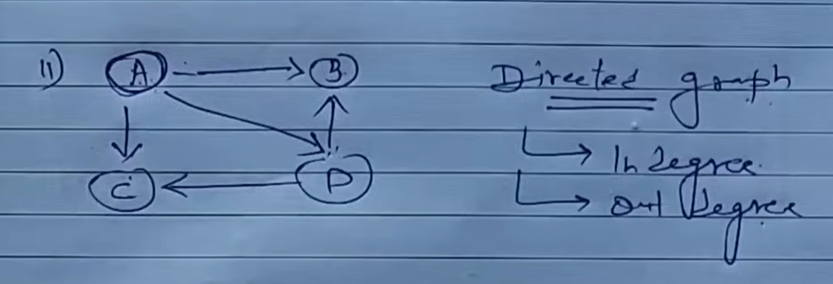
Types of Degree
Indegree
Indegree Total number of incoming edges connected to a vertex is said to be indegree of that vertex.
Outdegree
Outdegree Total number of outgoing edges connected to a vertex is said to be outdegree of that vertex.
A ⇒ Indegree – 0
Outdegree – 2

Slide 14
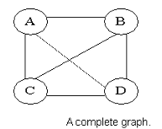
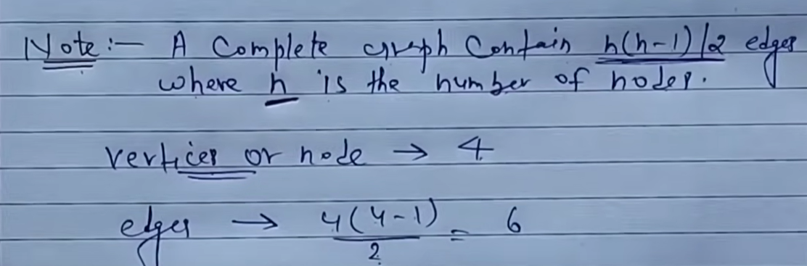
4.Complete Graph
If all the nodes of graph connected to each other then its called Complete Graph.
A graph in which any V node is adjacent to all other nodes present in the graph is known as a complete graph. An undirected graph contains the edges that are equal to edges = n(n-1)/2 where n is the number of vertices present in the graph. The following figure shows a complete graph.

Slide 15
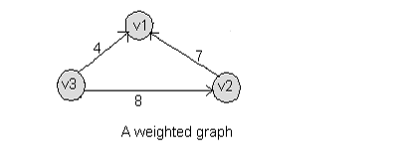
5. Weighted Graph
If edge of graph are assigned with value or weight then its called Weighted Graph.

Slide 16
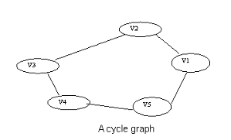
6.Cycle Graph
A graph having cycle is called cycle graph. In this case the first and last nodes are the same. A closed simple path is a cycle.

Slide 17
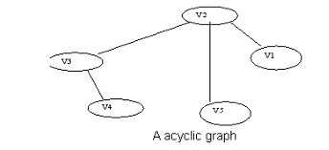
7.Acyclic Graph
A graph without cycle is called acyclic graphs.

Slide 18
ADT of Graph
Structure Graph is objects:
objects: a nonempty set of vertices and a set of undirected edges, where each edge is a pair of vertices
functions: for all graph Graph, v, v1 and v2 Vertices.
Graph Create()::=return an empty graph
Graph InsertVertex(graph, v)::= return a graph with v inserted. v has no edge.
Graph InsertEdge(graph, v1,v2)::= return a graph with new edge between v1 and v2
Graph DeleteVertex(graph, v)::= return a graph in which v and all edges incident to it are removed.
Graph DeleteEdge(graph, v1, v2)::=return a graph in which the edge (v1, v2) is removed
Boolean IsEmpty(graph)::= if (graph==empty graph) return TRUE else return FALSE
List Adjacent(graph,v)::= return a list of all vertices that are adjacent to v

Slide 19
Graph Representations
Graph data structure is represented using following representations
1. Adjacency Matrix
2. Adjacency List

Slide 20
1.Adjacency Matrix
In this representation, graph can be represented using a matrix of size total number of vertices by total number of vertices; means if a graph with 4 vertices can be represented using a matrix of 4X4 size.
In this matrix, rows and columns both represent vertices.
Adjacency Matrix : let G = (V, E) with n vertices, n
1. The adjacency matrix of G is a 2-dimensional n n matrix, A, A(i, j) = 1 iff (vi, vj) E(G) (vi, vj for a diagraph), A(i, j) = 0 otherwise.

Slide 21
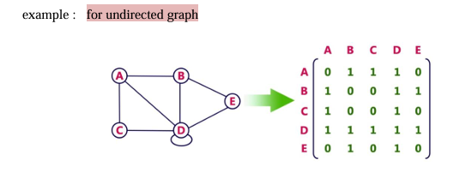

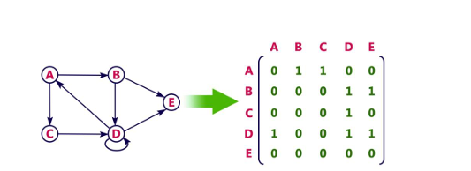

Slide 22
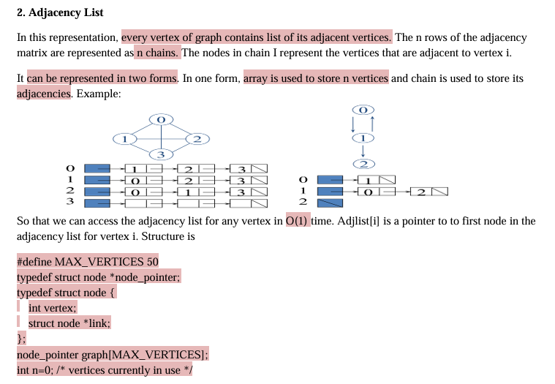

Slide 23
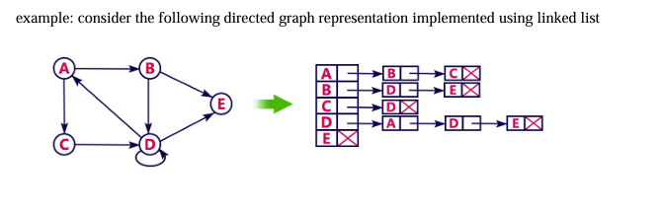

Slide 24
Graph Traversal
To traverse a Graph means to start in one vertex, and go along the edges to visit other vertices until all vertices, or as many as possible, have been visited.
It is a technique used for searching a vertex in graph It is also used to decide the order of vertices to be visited in the search process.
Two types of graph traversal techniques
DFS (Depth First Search) ⟶ stack (LIFO)
BFS (Breadth First Search) ⟶ queue (FIFO)
DFS is usually implemented using a Stack or by the use of recursion (which utilizes the call stack), while BFS is usually implemented using a Queue.

Slide 25
Depth First Search Traversal (DFS)
Depth First Search is said to go "deep" because it visits a vertex, then an adjacent vertex, and then that vertex' adjacent vertex, and so on, and in this way the distance from the starting vertex increases for each recursive iteration.
Rule 1: Visit the adjacent unvisited vertex. Mark it as visited. Display it. Push it in a Stack.
Rule 2: If no adjacent vertex is found, pop up a vertex from the stack. (It will delete all the vertices from the stack, which do not have adjacent vertex).
Rule 3: Repeat rule 1 & 2 until stack is empty.

Slide 26
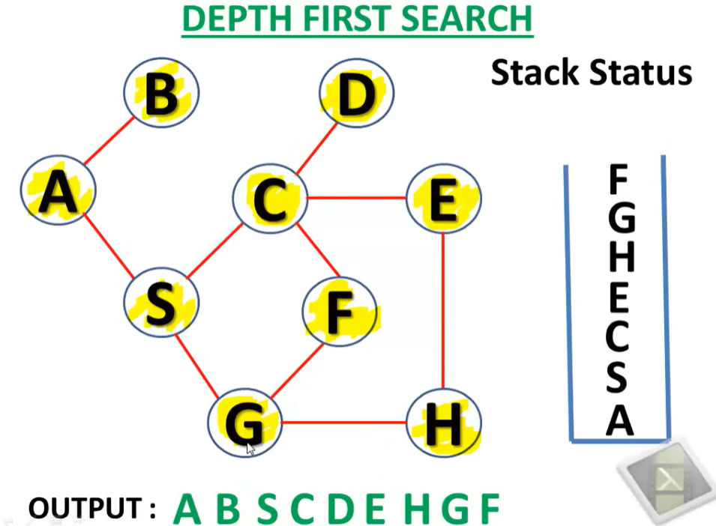

Slide 27
BFS
Breadth First Search visits all adjacent vertices of a vertex before visiting neighboring vertices to the adjacent vertices. This means that vertices with the same distance from the starting vertex are visited before vertices further away from the starting vertex are visited.
Rule 1: Visit the adjacent unvisited vertex. Mark it as visited. Display it. Insert it in a queue.
Rule 2: If no adjacent vertex found, remove the next vertex from the queue.
Rule 3: Repeat Rule 1 & 2 until queue is empty.

Slide 28
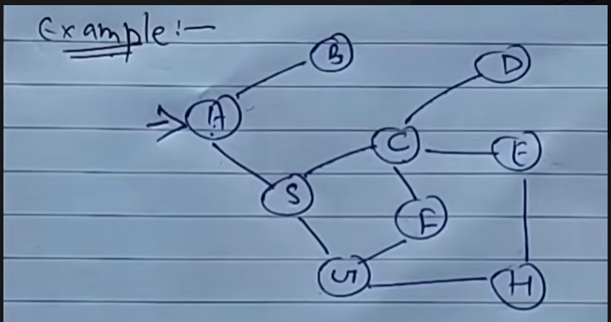
E.g. BFS

Slide 29
🔁 BFS Algorithm (Starting from A):
BFS visits all neighbors level by level.
Step-by-step traversal:
Start at A → enqueue A
Dequeue A, visit neighbors: B, S
Dequeue B → no children
Dequeue S, visit C, G
Dequeue C, visit D, E, F
Dequeue U, visit H
Dequeue D, E, F
Dequeue H
Ans:-
A → B → S → C → U → D → E → F → H

Slide 30
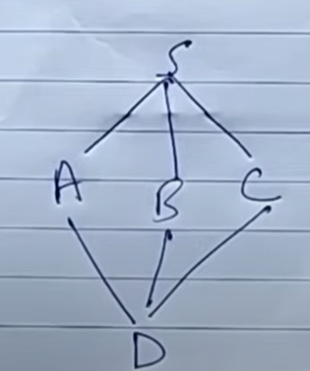
BFS E.g

Slide 31
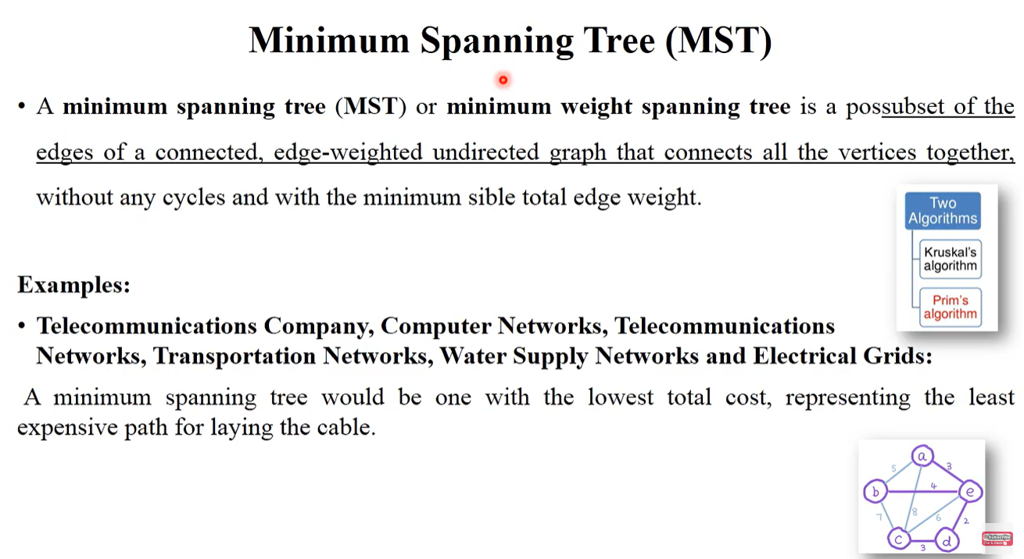

Slide 32
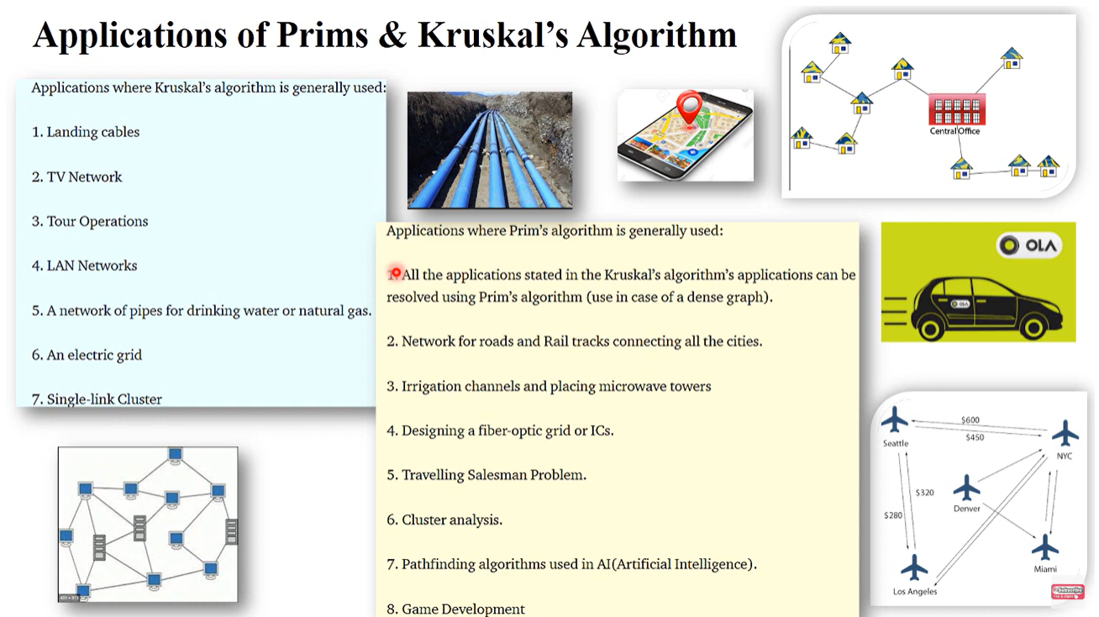

Slide 33
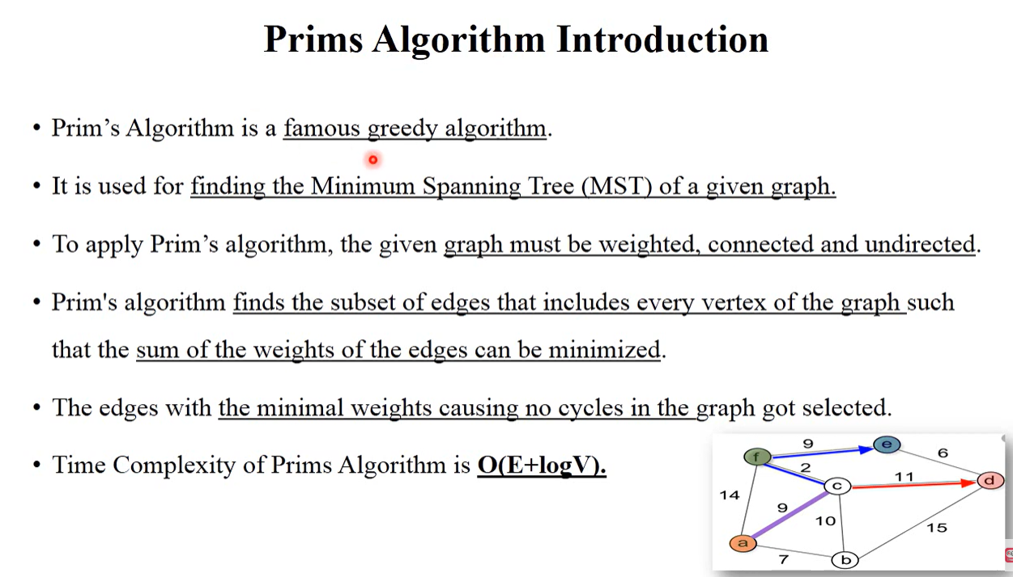

Slide 34
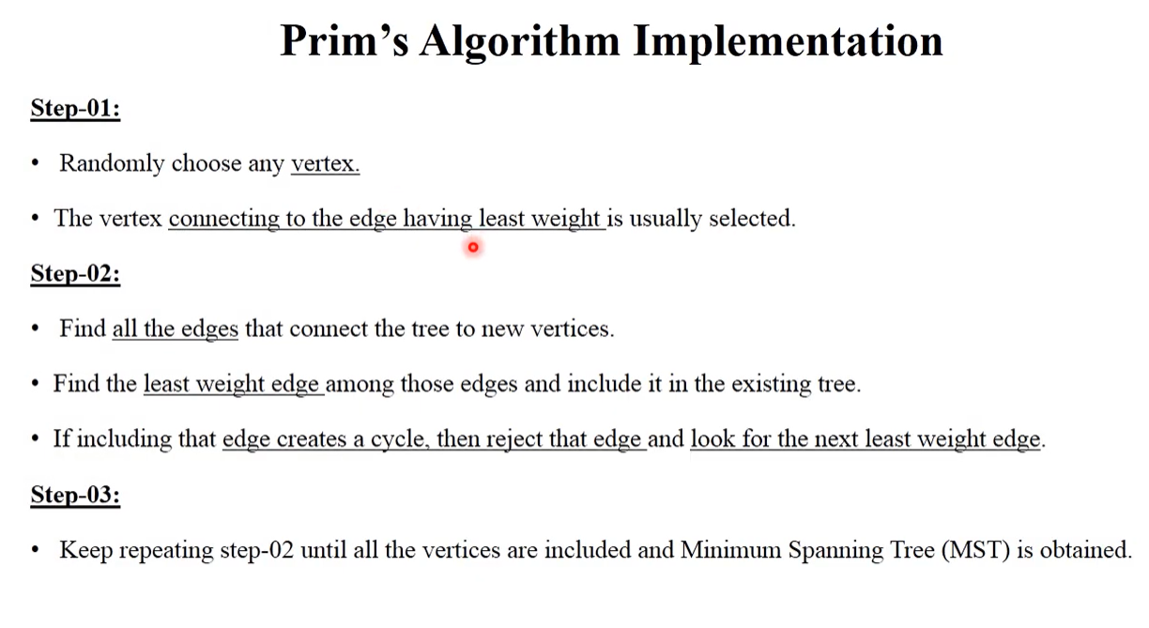

Slide 35
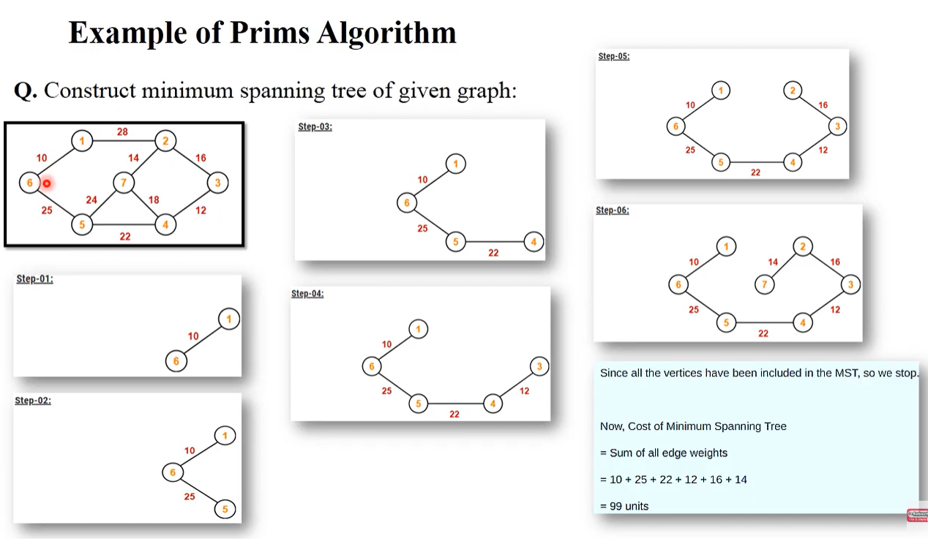

Slide 36
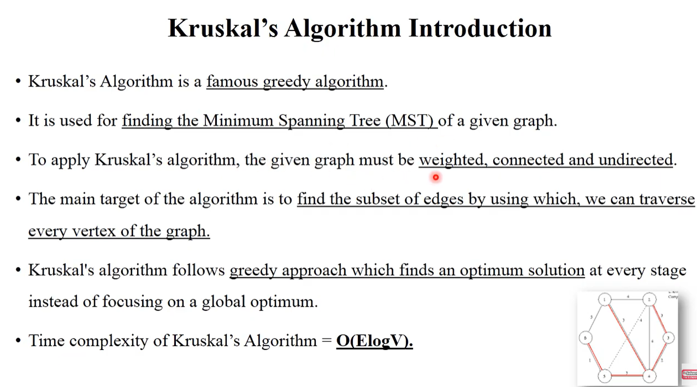

Slide 37
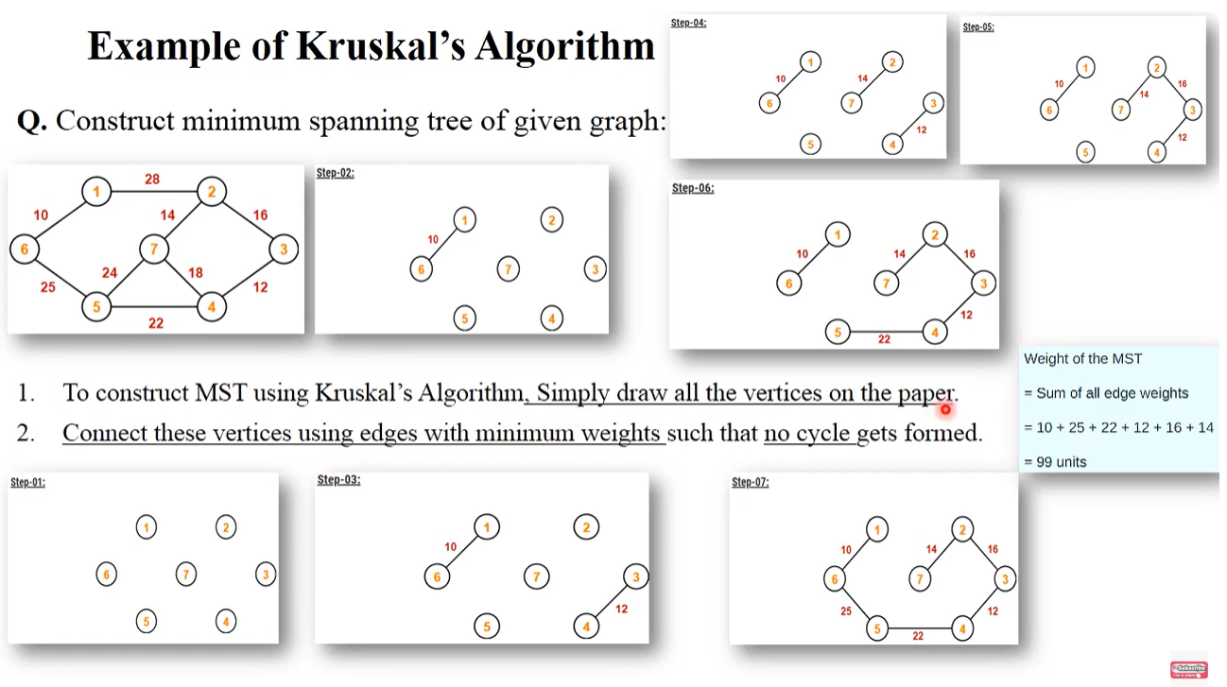

Slide 38
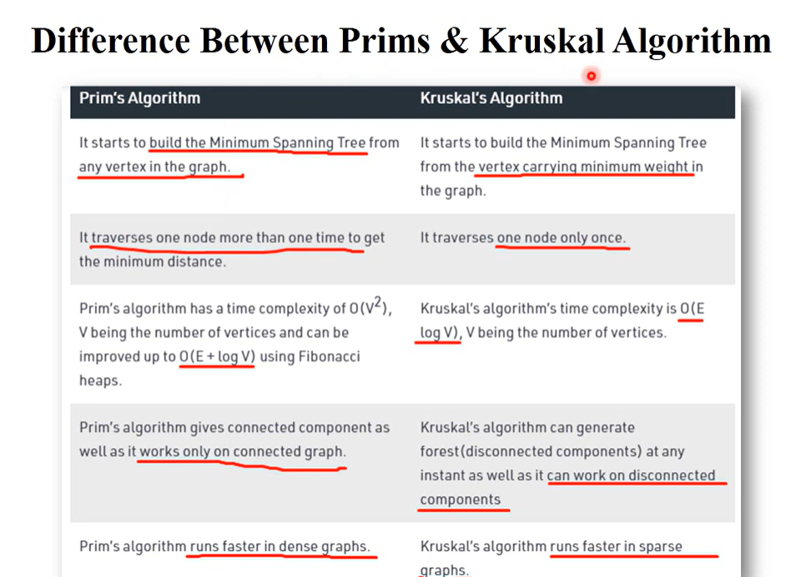

Slide 39
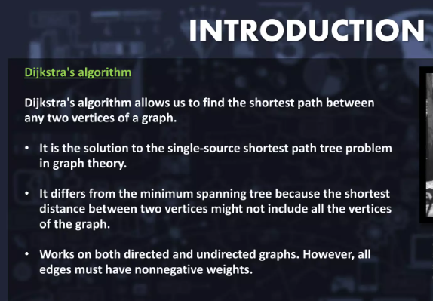
Dijkstra’s Algorithm

Slide 40
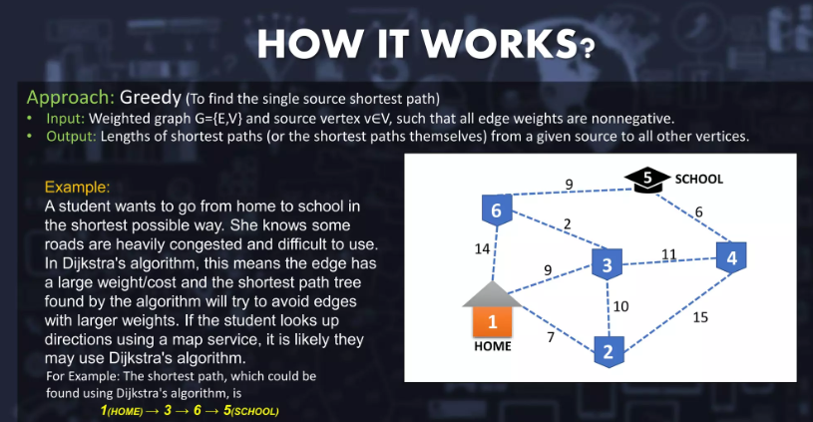

Slide 41
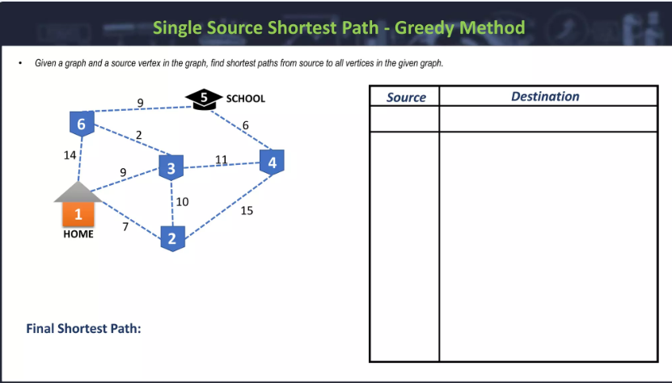

Slide 42
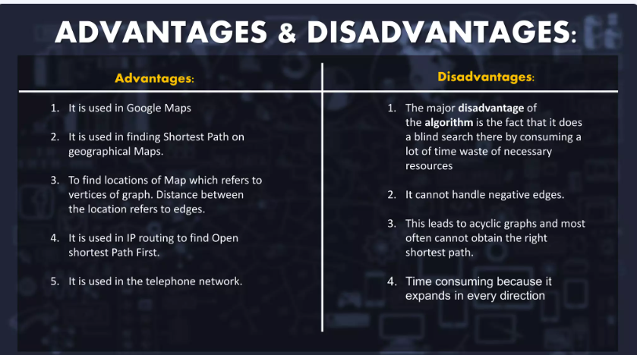

Slide 43
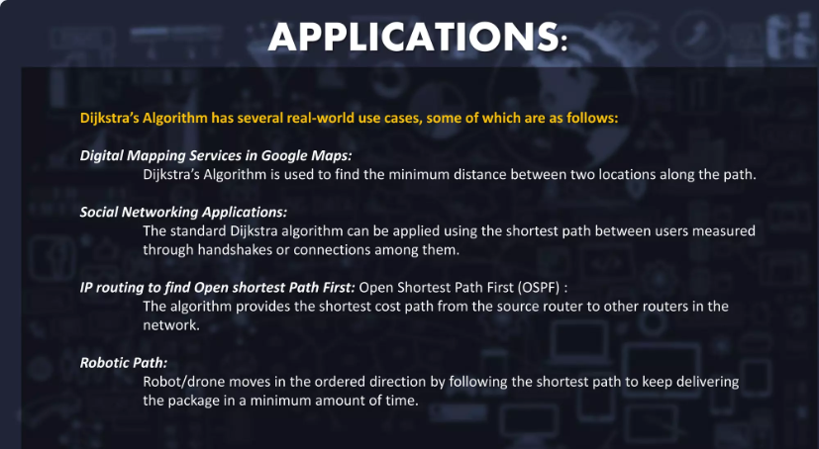

Slide 44
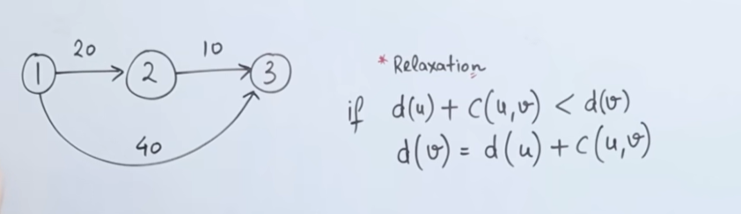
Example of Dijkstra Algorithhm

Slide 45
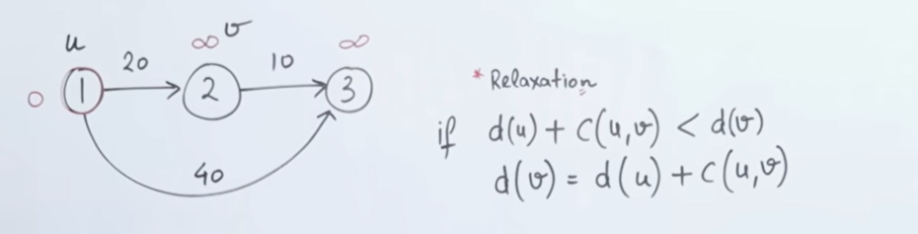

Slide 46
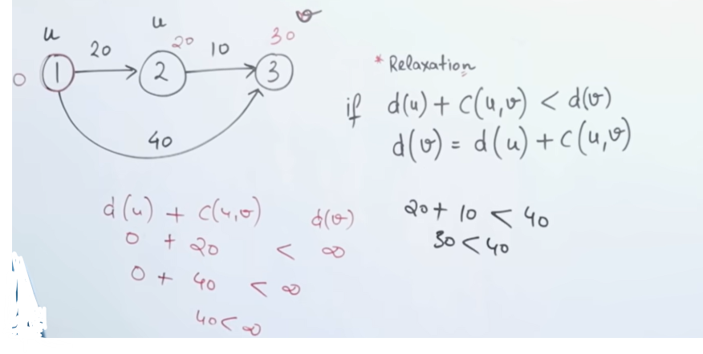

Slide 47
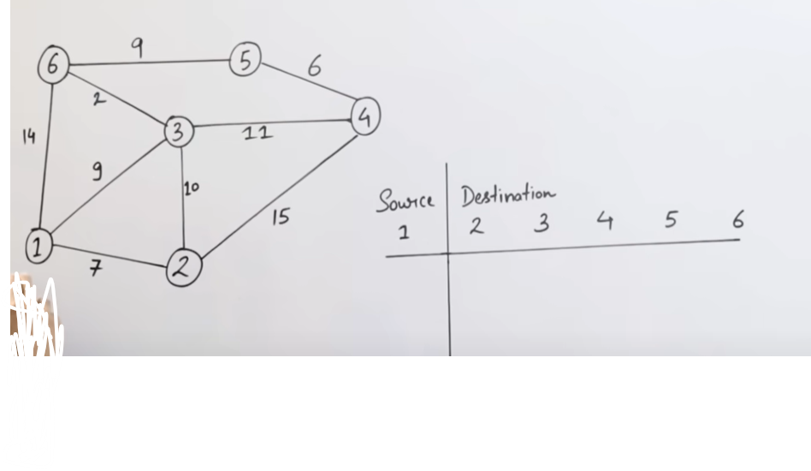
Example

Slide 48
